Slide 1


Automating a Pneumatic Launcher
By Alexander Walter

Slide 2
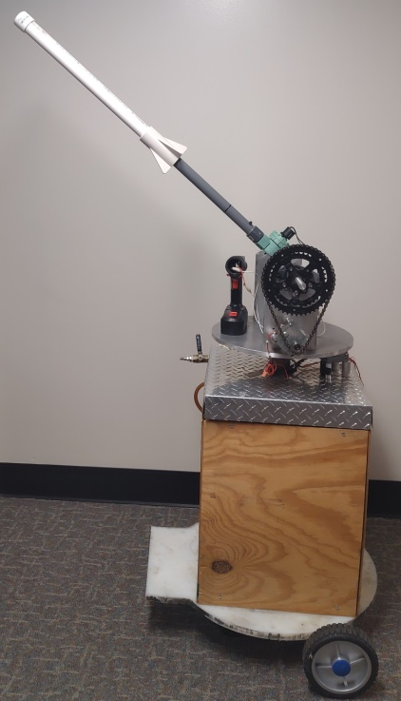
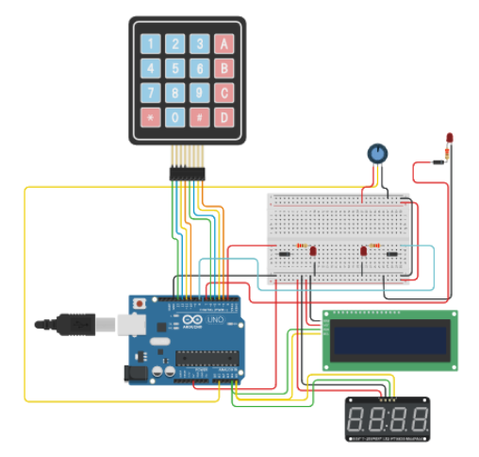
Background
Engineering Department has a rocket launcher that is used for ENGR-1201 projects.
For my Programming For Engineers final exam I had to automate this launcher.
Initial iteration was made in simulation software.
LEDs simulated valve operation.
Potentiometer (Dial) simulates pressure signal.
User would navigate a menu on the LCD using the keypad.

Slide 3
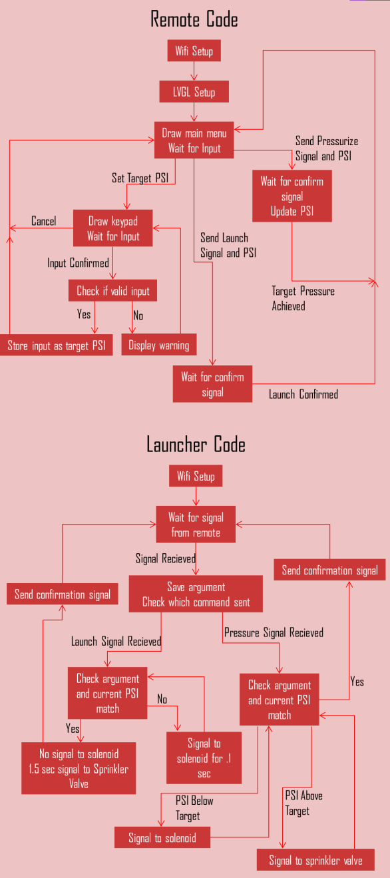
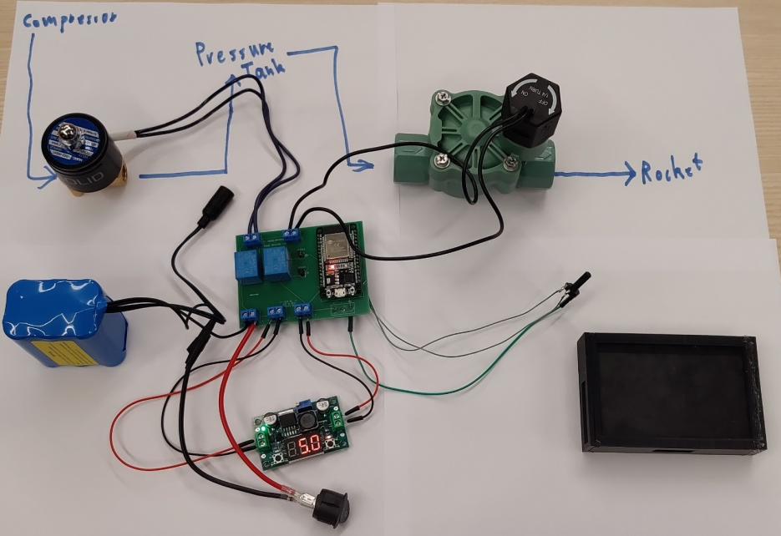
Spring ARISE Iteration
Launch controller was operated remotely via Bluetooth
12 volt battery was used to provide enough power to operate the valves
Relays used to actuate valves
Arduino replaced with ESP-32s
Buck Converter used to provide 5 volt power to ESP-32
Graphics refused to work
All other systems worked correctly

Slide 4
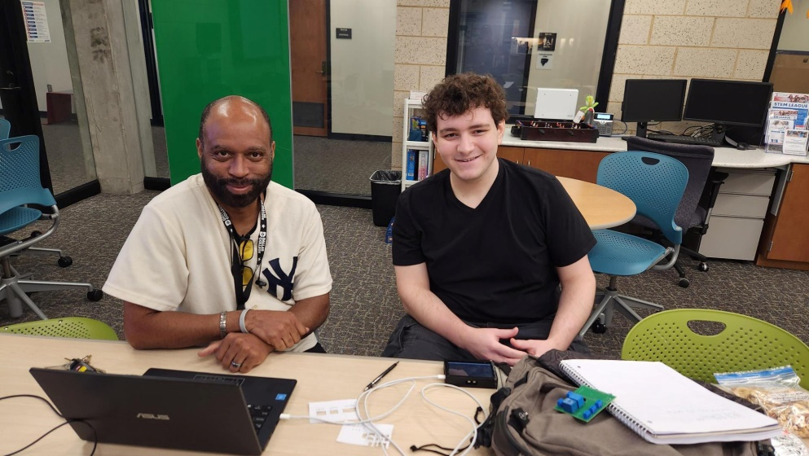
Changes Made in Fall
Breakout Board to interface with ESP-32
Supplies additional 5 volt power source
Host a webserver instead of connecting with bluetooth
Longer range than bluetooth
User interface designed with html instead of lvgl
More support for html
ESP-32 with screen replaced with web browser
Any computer with internet access can control the launcher

Slide 5
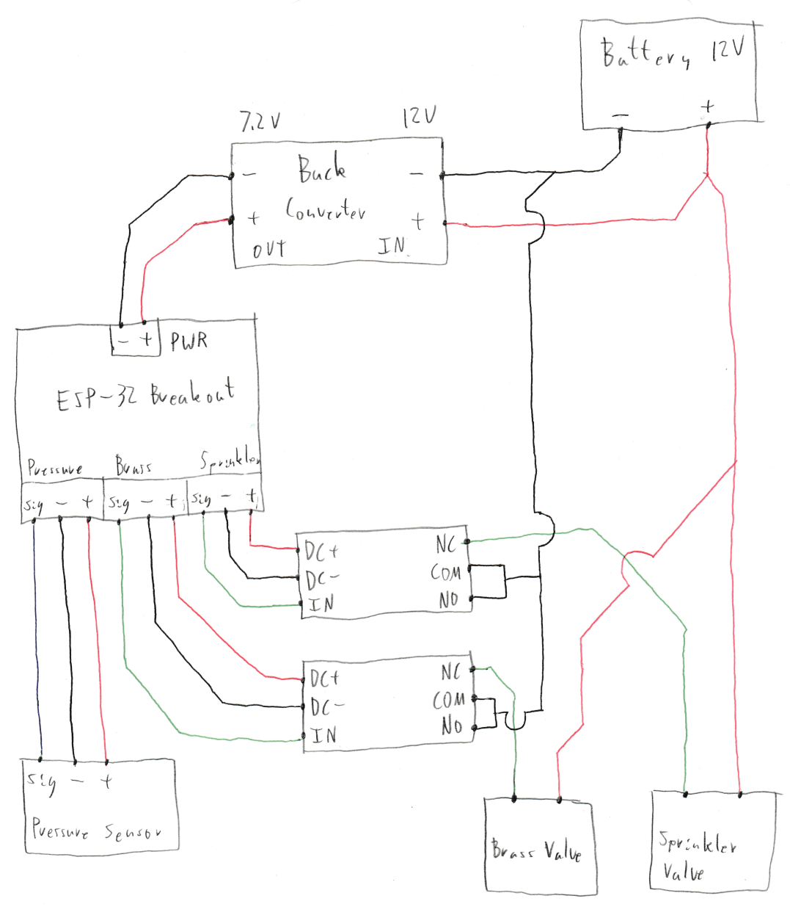
Circuit
No longer need transistors
New relays isolate signal source
Breakout board requires 7 volts instead of 5 volts
5 volt source used to power pressure sensor

Slide 6
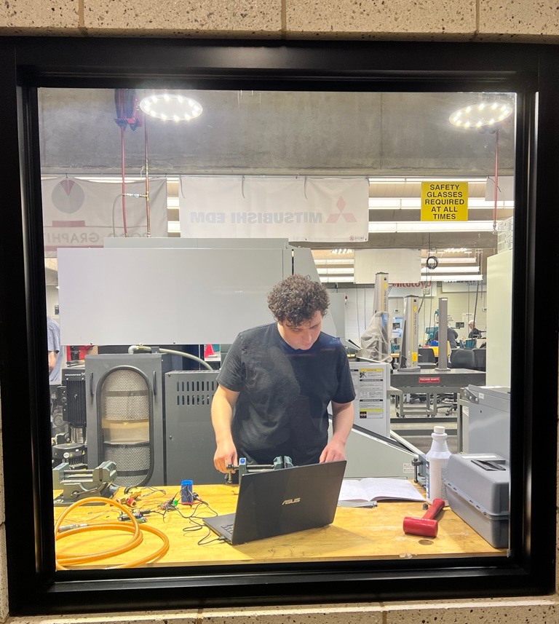
Components
Pressure sensor used to read pressure data
Can output a higher signal than the ESP-32 can read
Was able to map 3.3 volts to 90 PSI
Breakout board used to interface with ESP-32
Provides power sources for 5 and 3.3 volts
Easier to connect wires to signal pins
ESP-32-S3 used to control launcher
More powerful than previous controller
Has more pins to interface with

Slide 7
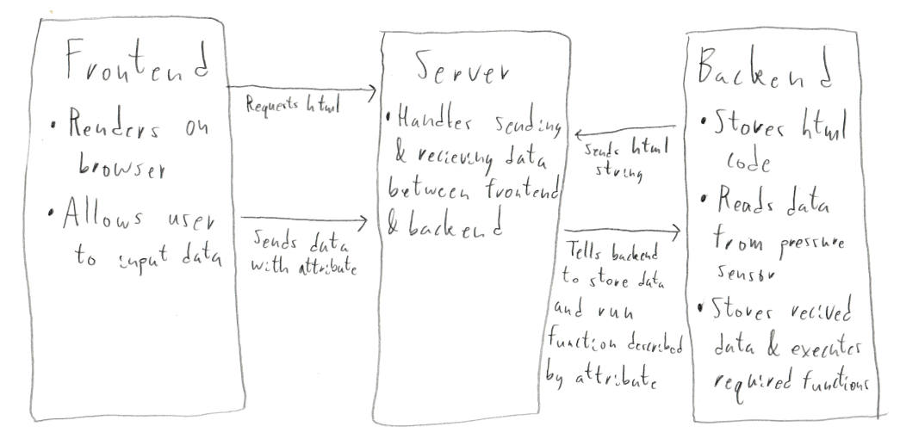
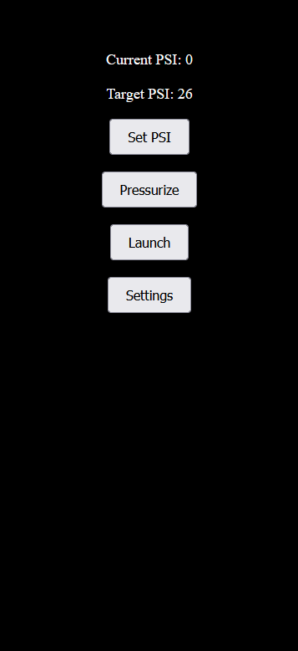
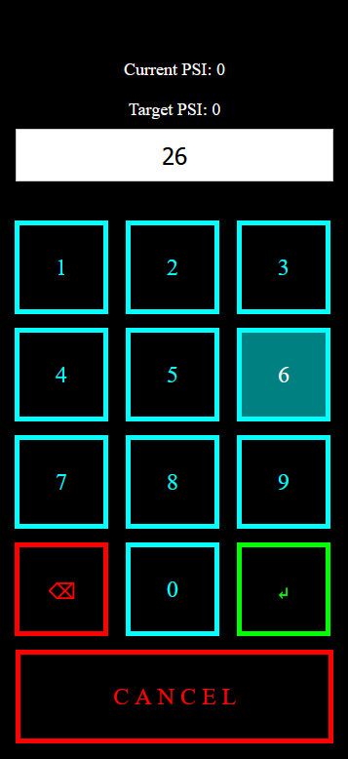
Code
ESP-32 runs server and needs code to send and receive data
Code run periodically to ensure communication
Is the “glue” between the frontend and backend
HTML is used to render the user interface on a remote device
Javascript used to allow menu to react to new data and user input
Backend used to interpret data from client
Provides data to the server and reacts to received data
Controls actual launcher components

Slide 8
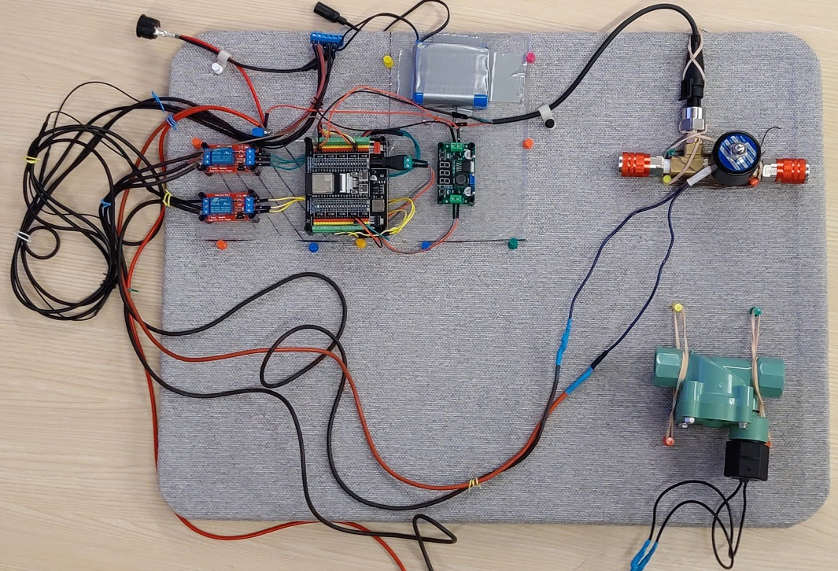
Results
All electrical components mounted to plexiglass
All components ready to be installed on the launcher
Final test of all components was a success
Current Issues
Max readable signal value happens at 90 PSI
Have to use serial moniter to get IP address for webserver
Exposed wires and connections

Slide 9
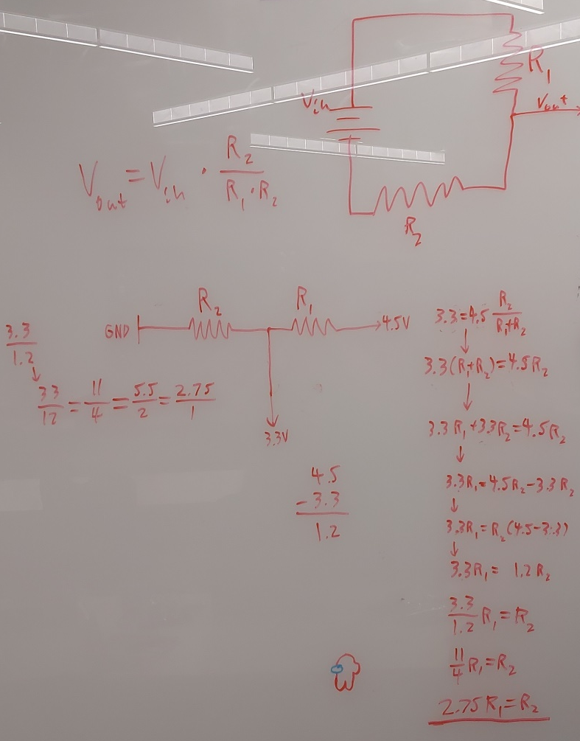
Future Improvements
Either use logic level converter or voltage divider for pressure signal
Use wifi mesh to connect to launcher
Ability to change wifi connection without recompiling
PCB to replace wires
Housing for electrical components

Slide 10
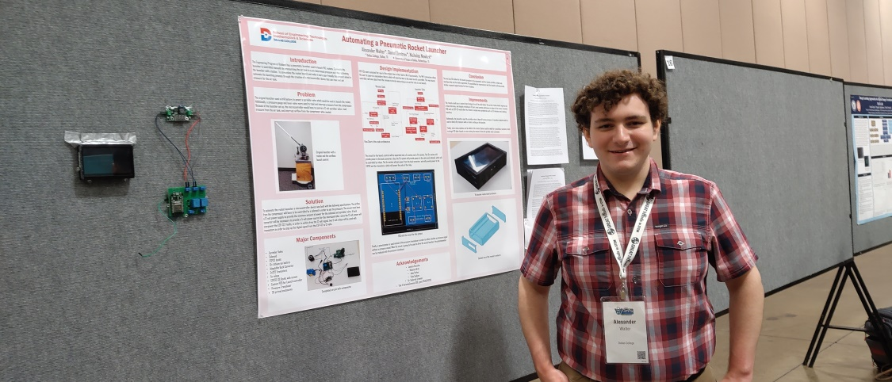
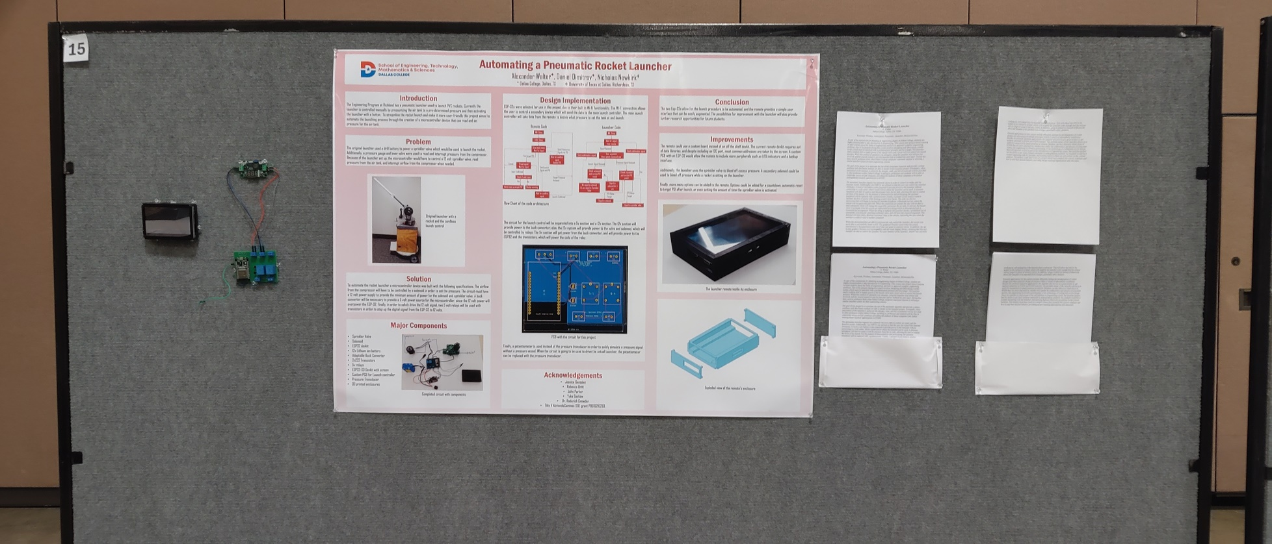
Closing Remarks
I encourage all of you to continue in your research
I would like to thank Dr. Crowder, the facilitators and volunteers of the Arduino ARISE, and Jessica Gonzales
Title V AbriendoCaminos DOE grant P031S210233

